Slide 1


Noida Institute of Engineering and Technology, Greater Noida
Introduction
Unit:1
Introduction
Ms. MANISHA
Assistant Professor
Computer
Course Details B Tech 6th Sem

Slide 2

Faculty Introduction
Faculty Name: Ms. Manisha
Designation: Assistant Professor

Slide 3
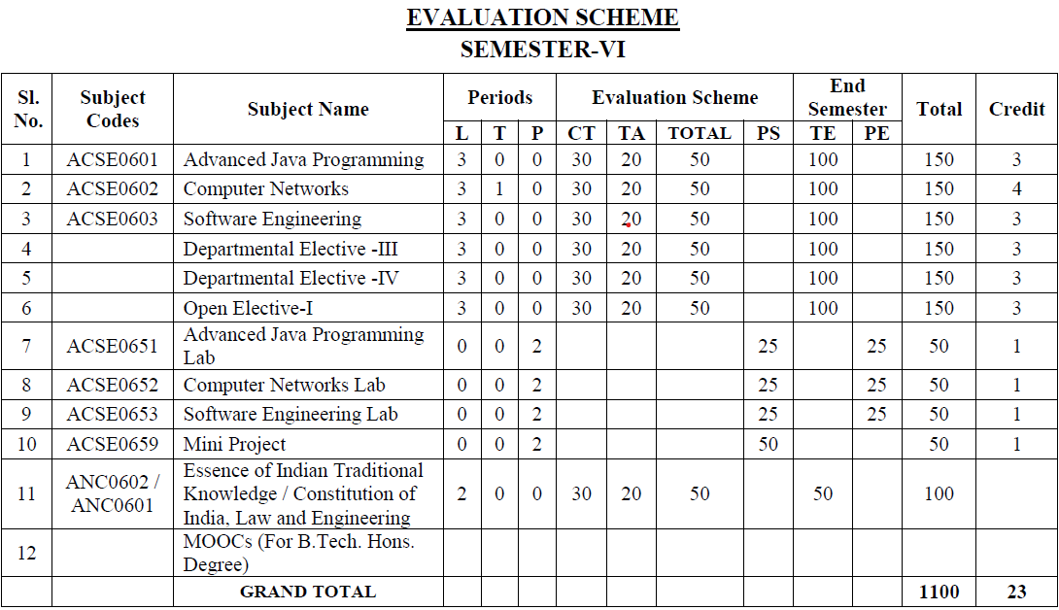
Evaluation Scheme

Slide 4
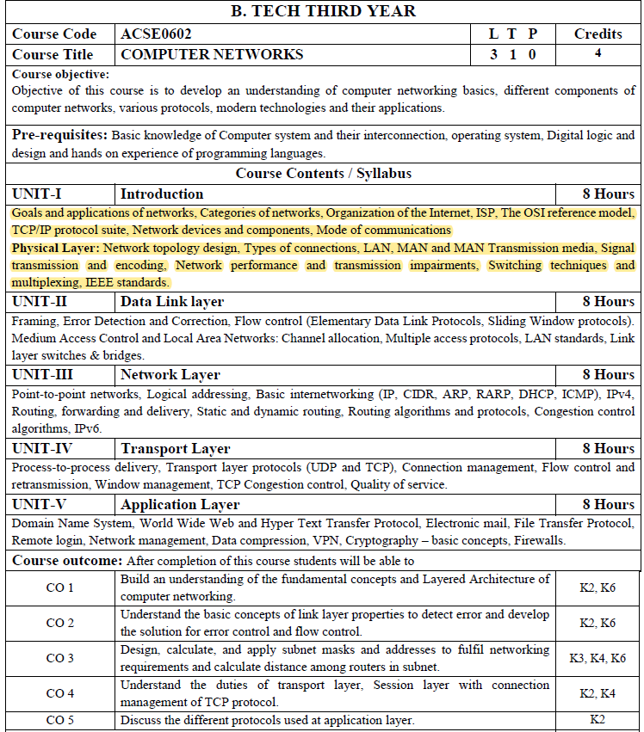
Syllabus

Slide 5
Syllabus
Unit | Topic
I | Introduction: Goals and applications of networks, Categories of networks, Organization of the Internet, ISP, The OSI reference model, TCP/IP protocol suite, Network devices and components. Mode of communication Physical Layer: Network topology design, Types of connections, LAN, MAN, and WAN Transmission media, Signal transmission and encoding, Network performance and transmission impairments, Switching techniques and multiplexing, IEEE standards.

Slide 6
Branch wise Applications
Resource Sharing
Server-Client model:
Communication Medium:
Access to remote information
Person-to-person communication
Electronic commerce
Cloud-based Applications
AI and Expert System
Neural Networks and parallel programming
Decision support and office automation systems etc.

Slide 7
Course Objective
To develop an understanding of
To understand computer networking basics.
To understand different components of computer networks.
To study and understand various protocols.
The standard models for the layered approach to communication between autonomous machines in a network.
To study and understand the main characteristics of data transmission across various physical link types.

Slide 8
Course Outcome
At the end of the course, the student will be able
Course Outcomes (CO) |  | Bloom’s Knowledge Level (KL)
C602.1 | Explain basic concepts, OSI reference model, services and role of each layer of OSI model and TCP/IP, networks devices and transmission media, Analog and digital data transmission | K1, K2
C602.2 | Apply channel allocation, framing, error and flow control techniques. | K3
C602.3 | Describe the functions of Network Layer i.e. Logical addressing, subnetting & Routing Mechanism | K2, K3
C602.4 | Explain the different Transport Layer function i.e. Port addressing, Connection Management, Error control and Flow control mechanism. | K2, K3
C602.5 | Explain the functions offered by session and presentation layer and their Implementation. | K2, K3
C602.6 | Explain the different protocols used at application layer i.e. HTTP, SNMP, SMTP, FTP, TELNET and VPN. | K2

Slide 9
Program Outcome
1. Engineering knowledge
2. Problem analysis
3. Design/development of solutions
4. Conduct investigations of complex problems
5. Modern tool usage
6. The engineer and society
7. Environment and sustainability
8. Ethics
9. Individual and team work
10. Communication
11. Project management and finance
12. Life-long learning

Slide 10
CO-PO Mapping
The highlighted text shows the mapping of course outcome with PO mapping of this unit
Computer Networks (KCS-603) |  |  |  |  |  |  |  |  | Year of Study: 2021-22
CO | PO1 | PO2 | PO3 | PO4 | PO5 | PO6 | PO7 | PO8 | PO9 | PO10 | PO11 | PO12
C602.1 | 3 | 2 | 3 | 2 | 1 | 1 |  |  |  |  | 2 | 3
C602.2 | 3 | 3 | 2 | 2 | 3 | 2 |  | 1 |  |  | 1 | 3
C602.3 | 3 | 2 | 1 |  | 1 | 2 |  | 1 | 2 |  | 1 | 3
C602.4 | 2 | 2 | 1 |  | 1 |  |  | 1 | 1 |  | 1 | 3
C602.5 | 2 | 2 | 2 |  | 1 |  |  |  |  |  | 1 | 3
C602.6 | 2 | 1 |  |  | 3 | 2 |  | 3 | 1 |  | 1 | 3

Slide 11
Program Specific Outcomes
PSO1: Apply suitable techniques, modern tools to solve complex engineering problems in the field of computer science.
PSO2:Design and optimize, ethical and innovative solutions for the betterment of the society.
PSO3:Work as an individual or lead in a team with good communication and engage in life-long learning.
PSO4: Practice multi-disciplinary and modern computing techniques by lifelong learning to establish innovative career.
PSO5: Work in a team or individual to manage projects with ethical concern to be a successful employee or employer in IT industry.

Slide 12
CO-PSO Mapping
The highlighted text shows the mapping of course outcome with PSO mapping of this unit
CO | PSO1 | PSO2 | PSO3 | PSO4
C602.1 | 3 | 3 | 2 | 1
C602.2 | 3 | 3 | 2 | 1
C602.3 | 3 | 3 | 2 | 1
C602.4 | 3 | 3 | 1 | 1
C602.5 | 3 | 3 | 1 | 1
C602.6 | 3 | 3 | 1 | 1

Slide 13
Program Educational Objectives
PEO1: able to apply sound knowledge in the field of information technology to fulfill the needs of IT industry.
PEO2: able to design innovative and interdisciplinary systems through latest digital technologies.
PEO3: able to inculcate professional and social ethics, team work and leadership for serving the society.
PEO4: able to inculcate lifelong learning in the field of computing for successful career in organizations and R&D sectors.

Slide 14
End Semester Question Paper Template
B TECH
(SEM-VI) THEORY EXAMINATION 20__-20__
Time: 3 Hours Total Marks: 100
Note: 1. Attempt all Sections. If require any missing data; then choose suitably.
SECTION A
Attempt all questions in brief. 2 x 10 = 20
Q.No. | Question | Marks | CO
1 |  | 2
2 |  | 2
. . |  | . .
10 |  | 2

Slide 15
End Semester Question Paper Templates
SECTION B
2. Attempt any three of the following: 3 x 10 = 30
SECTION C
3. Attempt any one part of the following: 1 x 10 = 10
Q.No. | Question | Marks | CO
1 |  | 10
2 |  | 10
. |  | .
5 |  | 10
Q.No. | Question | Marks | CO
1 |  | 10
2 |  | 10

Slide 16
End Semester Question Paper Templates
4. Attempt any one part of the following: 1 x 10 = 10
5. Attempt any one part of the following: 1 x 10 = 10
6. Attempt any one part of the following: 1 x 10 = 10
Q.No. | Question | Marks | CO
1 |  | 10
2 |  | 10
Q.No. | Question | Marks | CO
1 |  | 10
2 |  | 10
Q.No. | Question | Marks | CO
1 |  | 10
2 |  | 10

Slide 17
End Semester Question Paper Templates
7. Attempt any one part of the following: 1 x 10 = 10
Q.No. | Question | Marks | CO
1 |  | 10
2 |  | 10

Slide 18
Prerequisite
The student should have knowledge of
Networking
Layout of computer
Hardware
The basic knowledge of C

Slide 19
Brief Introduction to Subject
Computer network is a group of devices connected with each other through a transmission medium such as wires, cables etc.
These devices can be computers, printers, scanners, Fax machines etc.
The purpose of having computer network is to send and receive data stored in other devices over the network.

Slide 20
Communication (CO1)
Topic Objective
The student will get an insight of communications, networking
Medium used for transmission
Various topologies used
The LAN, WAN and MAN concept

Slide 21
Communication (CO1)
For communication we share the information
Data refers to any information
Data communication
exchange of data between two devices by some transmission medium.
Effectiveness of data communication depends on
Delivery
Accuracy
Timeliness
Jitter

Slide 22

Computer Networks (CO1)
A computer network is an interconnection of two or more computers that are able to exchange information
Network is a set of devices connected by communication link
The computer may be connected via any data communication link
Computers can be personal or main frames
The computer network may be located anywhere in the world and its size can vary
Generally follow a client server model.

Slide 23
Computer Networks (CO1)
How Does a Computer Network Work
The working of Computer Networks can be simply defined as rules or protocols which help in sending and receiving data via the links which allow Computer networks to communicate. Each device has an IP Address, that helps in identifying a device.

Slide 24
Computer Networks (CO1)
The goals of a computer network
The goals of a computer network are to reduce cost, increase reliability, flexibility, and productivity
The following are some of the important goals of computer networks:
1. Performance –
It is measured in terms of transit time and response time.
Transit time is the time for a message to travel from one device to another
Response time is the elapsed time between an inquiry and a response.

Slide 25
Computer Networks (CO1)
Performance is dependent on the following factors:
The number of users
Type of transmission medium
Capability of connected network
Efficiency of software
Bandwidth
Network topology
Network protocols
Distance
Network congestion
Network hardware

Slide 26
Computer Networks (CO1)
Reliability – It is measured in terms of
Frequency of failure
Recovery from failures
Robustness during catastrophe
Quality of service (QoS)
Reducing single points of failure
Capacity planning
Network architecture
3. Security – It means protecting data from unauthorized access.
4. Network topology-
it is another crucial factor to consider when designing a computer network. It refers to the way in which computers, devices, and links are arranged in a network.

Slide 27
Computer Networks (CO1)
Goals of Computer Networks:
some important goals of computer networks:
Resource Sharing –
High Reliability –
Inter-process Communication-
Flexible access –
Security–
Performance
Scalability-

Slide 28
Computer Networks (CO1)
Basic Terminologies of Computer Networks
Network: A network is a collection of computers and devices that are connected together to enable communication and data exchange.
Nodes: Nodes are devices that are connected to a network. These can include computers, Servers, Printers, Routers, Switches, and other devices.
Protocol: A protocol is a set of rules and standards that govern how data is transmitted over a network. Examples of protocols include TCP/IP, HTTP, and FTP.
Topology: Network topology refers to the physical and logical arrangement of nodes on a network. The common network topologies include bus, star, ring, mesh, and tree.

Slide 29
Computer Networks (CO1)
Service Provider Networks: These types of Networks give permission to take Network Capacity and Functionality on lease from the Provider. Service Provider Networks include Wireless Communications, Data Carriers, etc.
IP Address: An IP address is a unique numerical identifier that is assigned to every device on a network. IP addresses are used to identify devices and enable communication between them.
DNS: The Domain Name System (DNS) is a protocol that is used to translate human-readable domain names (such as www.google.com) into IP addresses that computers can understand.
Firewall: A firewall is a security device that is used to monitor and control incoming and outgoing network traffic. Firewalls are used to protect networks from unauthorized access and other security threats.

Slide 30
Computer network Communication(CO1)
Components of Computer Networks:-
Message – information to be communicated
Sender – a device that sends the data
Receiver – a device that receives the data
Transmission medium – physical path by which message transmits
Protocol – a set of rules that govern data communications
We transmits information or data by two types of signals
Analog – telephones and radios
Digital - computers

Slide 31
Data representation
Text
Bit pattern, sequence of bits
set of bits – code, process is coding
Numbers
Number system
Images
Matrix of pixels
Size of the pixel depends on resolution
Audio
Continuous
Video
Continuous / combination of images

Slide 32
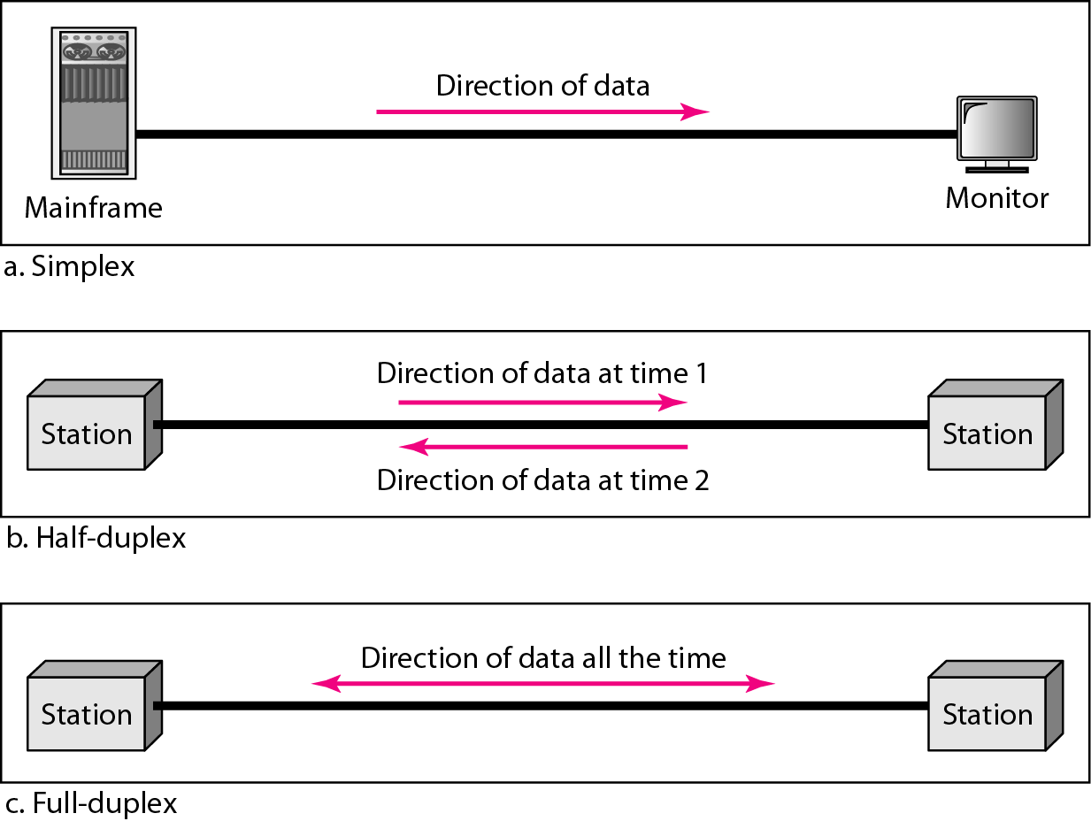
Modes of transmission(CO1)
Transmission mode means transferring data between two devices. It is also known as a communication mode. Buses and networks are designed to allow communication to occur between individual devices that are interconnected. There are three types:

Slide 33
Modes of transmission(CO1)
Simplex Mode
The communication is unidirectional, as on a one-way street. Only one of the two devices on a link can transmit, the other can only receive. The simplex mode can use the entire capacity of the channel to send data in one direction.
Example: Keyboard and traditional monitors.
Advantage: reliable, cost-effective, no need for coordination
Disadvantage: one-way communication, not suitable for applications that require bidirectional communication.
Half-Duplex Mode – In half-duplex mode, each station can both transmit and receive, but not at the same time. When one device is sending, the other can only receive, and vice versa. The half-duplex mode is used in cases where there is no need for communication in both directions at the same time. The entire capacity of the channel can be utilized for each direction.
Advantage: bidirectional , requires one communication channel.
Disadvantage: less reliable, need for coordination
Chanel capacity= bandwidth *propagation delay Example: Walkie-talkie

Slide 34
Modes of transmission(CO1)
Full-duplex
Full-duplex mode is used when communication in both directions is required all the time. The capacity of the channel, however, must be divided between the two directions.
Advantage: bidirectional communication, high level of reliability and accuracy
Disadvantage: most expensive mode, physically separate transmission
Chanel capacity= 2 *bandwidth *propagation delay Example: Telephone Network in which there is communication between two persons by a telephone line, through which both can talk and listen at the same time.

Slide 35
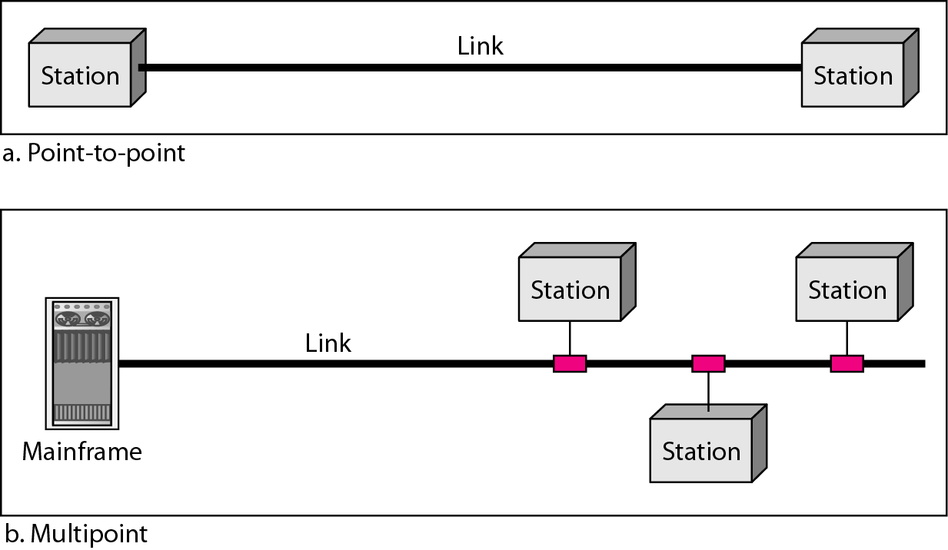
Computer networks
A network is a set of devices (often referred to as nodes) connected by communication links. A node can be a computer, printer, or any other device capable of sending and/or receiving data generated by other nodes on the network.
Types of connections

Slide 36
Computer networks
Distributed Processing
Most networks use distributed processing, in which a task is divided among multiple computers.
Instead of one single large machine being responsible for all aspects of a process, separate computer (usually a personal computer or workstation) handle a subset.
Point to Point WAN
A point to point WAN is a network that connect two communication devices through transmission media.
Switched WAN
A switched WAN is network with more than two ends.
Switching
It is the process of transferring data packets from one device to another in a network, or from one network to another, using specific devices called switches.

Slide 37
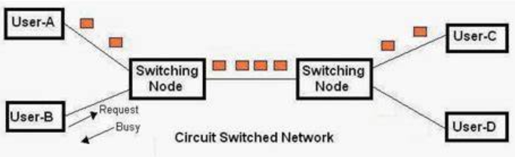
Computer networks
Circuit Switched Network
In a circuit Switched network a dedicated connection called a circuit , is always available between the two end system. The switch can be made it active and inactive.

Slide 38
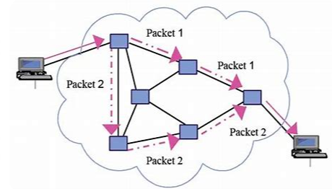
Computer networks
Packet Switched Network
A packet-switched network (PSN) is a kind of computer communications network that sends data in the form of small packets.
It is a queue that can store and Forword the packets.
It allows the sender to send data or network packets to the source and destination node over an internet network channel that is transferred between multiple users and/or applications.
A packet-switched is also called a connectionless network, as it does not create an endless connection between a source and destination points.

Slide 39
Computer networks
Network Criteria
Performance
Transmit time is the amount of time required for a message to travel from one device to another.
Response time is the elapsed time between an inquiry and a response.
depends on
the number of users,
the type of transmission medium,
the capabilities of the connected hardware,
and the efficiency of the software.
evaluated by two networking metrics: throughput and delay.

Slide 40
Computer networks
Network Criteria
Reliability
the frequency of failure,
the time it takes a link to recover from a failure.
Security
protecting data from unauthorized access,
protecting data from damage and development,
and implementing policies and procedures for recovery from breaches and data losses.

Slide 41
Computer networks
Applications of networking
Accessing Remote Database
Virtual Access Communication Facility
Marketing & Sales
Financial Services
Manufacturing
E-messages
Direct Services
Teleconferencing
Cable TV

Slide 42
Computer networks
Network Devices: Network devices, also known as networking hardware, are physical devices that allow hardware on a computer network to communicate and interact with one another. For example Repeater, Hub, Bridge, Switch, Routers, Gateway, Boutre, and NIC, etc.
1.Repeater – A repeater operates at the physical layer. Its job is to regenerate the signal over the same network before the signal becomes too weak or corrupted to extend the length to which the signal can be transmitted over the same network.
2. Hub – A hub is a basically multi-port repeater. A hub connects multiple wires coming from different branches, for example, the connector in star topology which connects different stations. Hubs cannot filter data, so data packets are sent to all connected devices.
Types of Hub
Active Hub
Passive Hub
Intelligent Hub

Slide 43
Computer networks
3. Bridge – A bridge operates at the data link layer. A bridge is a repeater, with add on the functionality of filtering content by reading the MAC addresses of the source and destination.
4. Switch - A switch is a data link layer device. The switch can perform error checking before forwarding data, which makes it very efficient as it does not forward packets that have errors and forward good packets selectively to the correct port only.

Slide 44
Computer networks Topology
Network Topology
Topology defines the structure of the network of how all the components are interconnected to each other. There are two types of topologies: physical and logical topology.
Physical topology
A physical topology refers to the actual layout of devices and cables in a network. It's the blueprint of how things are physically connected, like the wiring in your house or the streets in a city.
Star Topology
Bus Topology
Ring Topology
Mesh Topology

Slide 45
Computer networks Topology
Logical topology,
A logical topology, in contrast to its physical counterpart, describes the virtual pathways data takes as it travels across a network, independent of the actual physical layout of cables and devices. It's like a map of how information flows.
Optimize data flow: Configure devices and protocols to efficiently route information.
Troubleshoot issues: Identify bottlenecks or malfunctions based on the virtual pathways.
Plan for future growth: Choose a logical topology that can scale with increasing network demand.

Slide 46
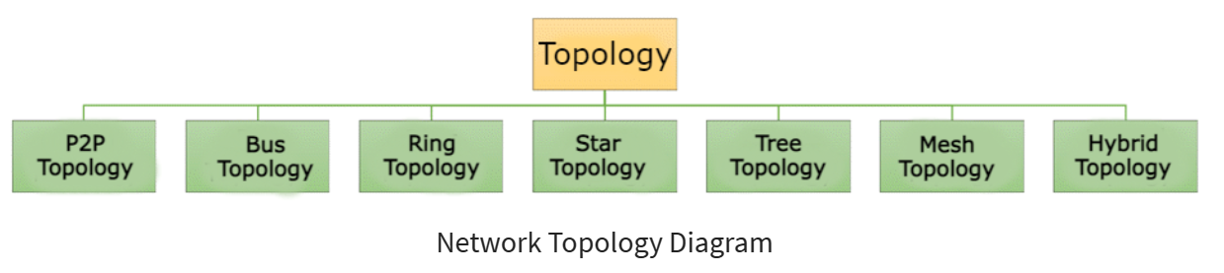
Computer networks Topology

Slide 47
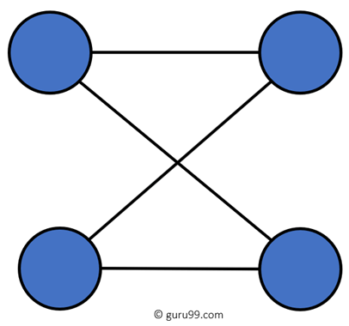
Computer networks Topology
Point to Point Topology
Point-to-Point Topology is a type of topology that works on the functionality of the sender and receiver. It is the simplest communication between two nodes
characteristics of point-to-point topology:
Simplicity: It's the simplest network layout, requiring only two devices and a single cable or other physical link.
Dedicated bandwidth: The entire bandwidth of the connection is reserved for the two devices, leading to potentially high speeds and low latency.
Limited scalability: It can only connect two devices directly, making it unsuitable for larger networks or those requiring flexible connections.
Single point of failure: If the link fails, communication between the two devices is completely disrupted.
Cost-effectiveness: For simple connections, it can be cost-effective due to minimal equipment and cabling requirements.

Slide 48
Computer networks Topology
Applications of point-to-point topology
Dedicated data links: Between servers in a data centre, connecting remote offices to headquarters, or linking critical infrastructure sites.
High-speed connections: Used for applications requiring high bandwidth and low latency, such as video conferencing, streaming media, or financial transactions.
Point-to-point VPNs: Securely connecting two remote points over a public network like the internet.
Consumer devices: Connecting printers, scanners, external hard drives, or gaming consoles directly to a computer.

Slide 49
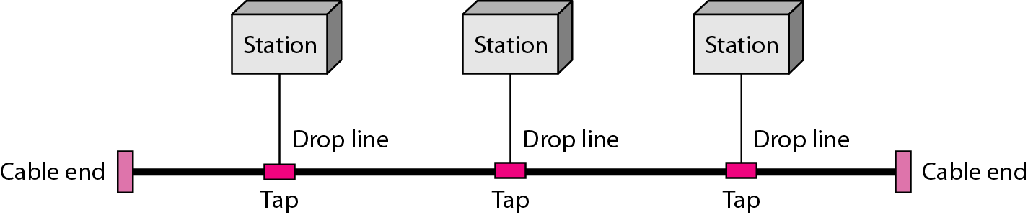
Computer networks Topology
Bus topology
Bus topology is a network configuration where all devices are connected to a single cable called a bus. where information can travel from one end to the other or to any specific individual in between.
Shared medium: A device wants to send data, it broadcasts it onto the bus, and all other devices receive it simultaneously.
Collision detection: To avoid confusion, devices typically use a protocol like Carrier Sense Multiple Access with Collision Detection (CSMA/CD) to "listen" before speaking. This prevents multiple devices from transmitting at the same time, which would lead to data collisions and corruption.
Addressing: Each device has a unique address, and data packets are labelled with the recipient's address. Only the device with the matching address processes the data, while others ignore it.

Slide 50
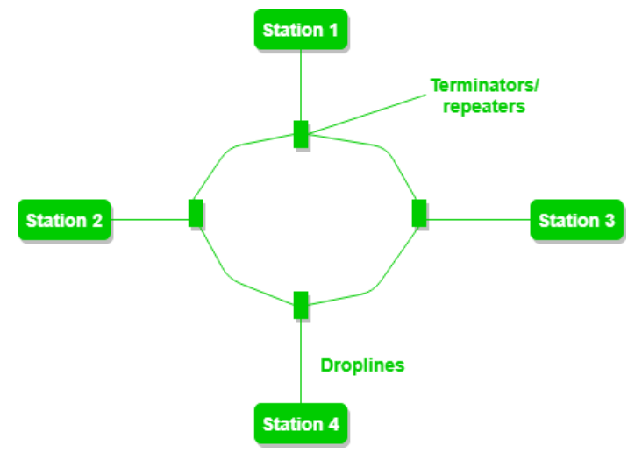
Computer networks Topology
Ring topology
Ring topology is another interesting network configuration where devices are connected in a closed loop, forming a circular path for data transmission. Imagine forming a circle with devices holding hands, where information continuously travels around the ring until it reaches its destination.
Continuous loop: Each device connects to its two neighbouring devices, creating a continuous path for data to flow in one direction (unidirectional) or both directions (bidirectional).
Token passing: In some ring networks, a special signal called a token circulates around the ring. Only the device holding the token is allowed to transmit data. This prevents collisions and ensures orderly data flow.
Addressing: Similar to other topologies, each device has a unique address, and data packets are labelled with the recipient's address. The packet travels around the ring until it reaches the device with the matching address, which then processes the data.

Slide 51
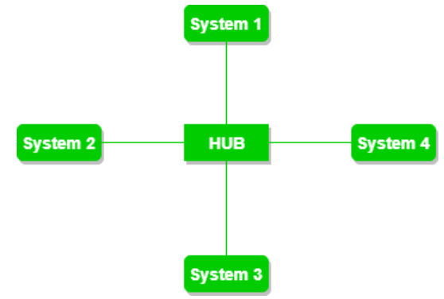
Computer networks Topology
Star Topology
In Star Topology, all the devices are connected to a single hub through a cable. This hub is the central node and all other nodes are connected to the central node. The hub can be passive in nature i.e., not an intelligent hub such as broadcasting devices, at the same time the hub can be intelligent known as an active hub. Active hubs have repeaters in them. Coaxial cables or RJ-45 cables are used to connect the computers. In Star Topology, many popular Ethernet LAN protocols are used as CD (Collision Detection), CSMA (Carrier Sense Multiple Access), etc.
Advantages
less expensive
easy to install and reconfigure
less cabling
Robustness
easy fault identification and fault isolation
Disadvantages
dependency of the whole topology on one single point, the hub
often more cabling is required

Slide 52
Topology(CO1)
Mesh Topology
A mesh topology is a network configuration where devices are interconnected in a web-like pattern, with each device connected to multiple other devices. This creates a redundant network with multiple paths for data to travel, making it highly fault-tolerant and scalable. the protocols used are AHCP (Ad Hoc Configuration Protocols), DHCP (Dynamic Host Configuration Protocol), etc.
every device has a dedicated point-to-point link to every other device.
the number of physical links in a fully connected mesh network with n nodes = n(n - 1)
Advantages
carry its own data load
Robust
privacy or security
fault identification and fault isolation easy
Disadvantages
amount of cabling and the number of I/O ports required
installation and reconnection are difficult
sheer bulk of the wiring
expensive

Slide 53
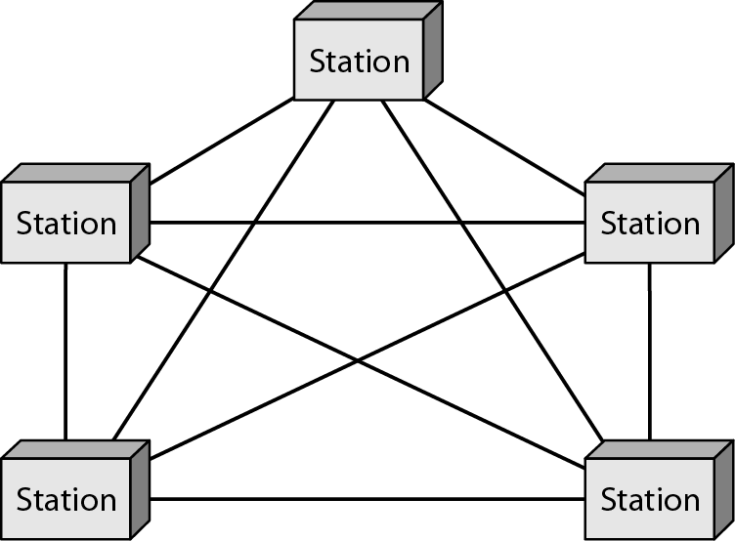
Topology (CO1)
Mesh Topology

Slide 54
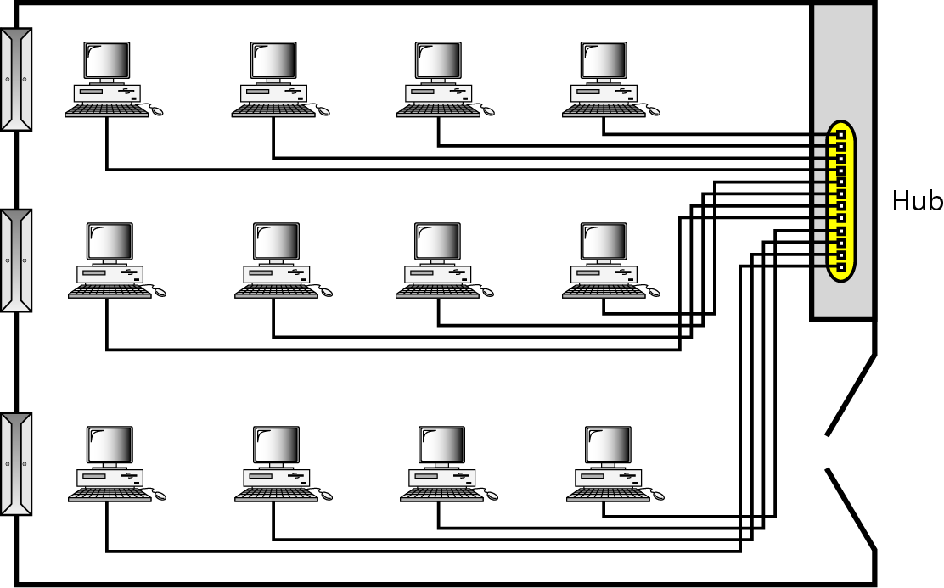
Types of Networks (CO1)
LAN
A local area network (LAN) is usually privately owned and links the devices in a single office, building, or campus
resources can be shared
In addition to size, LANs are distinguished from other types of networks by their transmission media and topology

Slide 55
Types of Networks (CO1)
MAN
A metropolitan area network (MAN) is a network with a size between a LAN and a WAN. It normally covers the area inside a town or a city.
It is designed for customers who need a high-speed connectivity, normally to the Internet, and have endpoints spread over a city or part of city

Slide 56
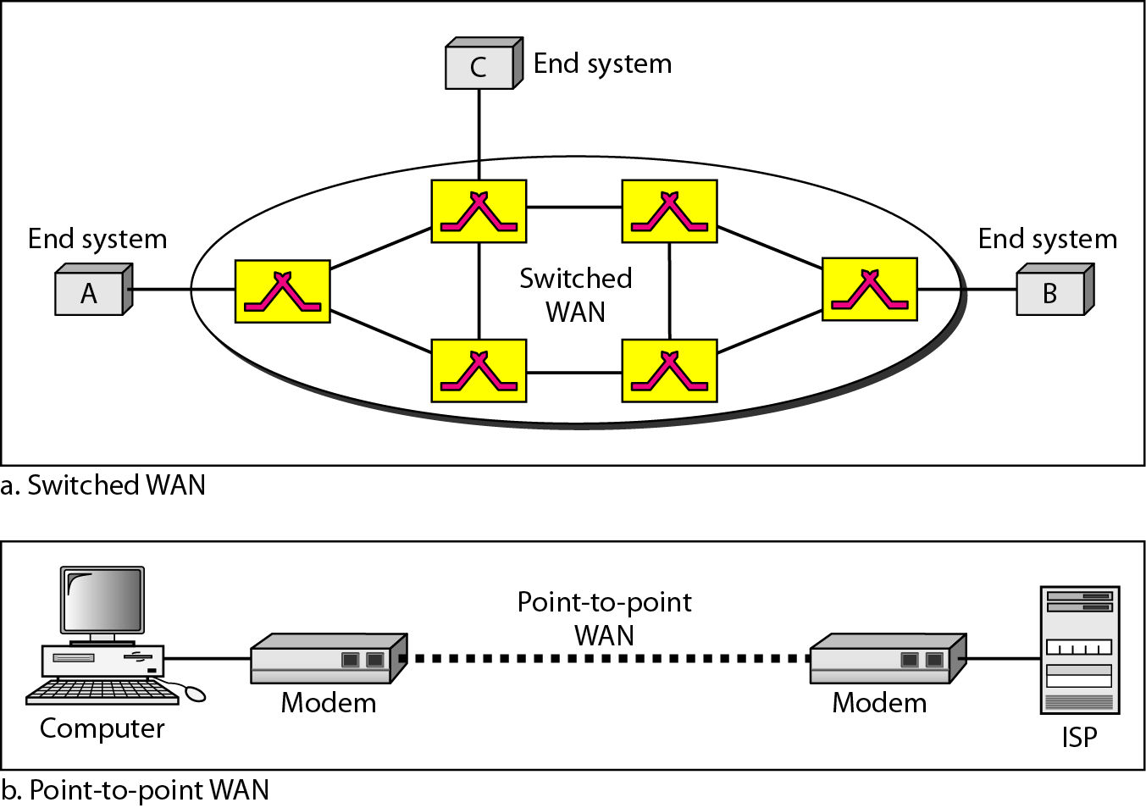
Types of Networks (CO1)
WAN
A wide area network (WAN) provides long-distance transmission of data, image, audio, and video information over large geographic areas that may comprise a country, a continent, or even the whole world

Slide 57
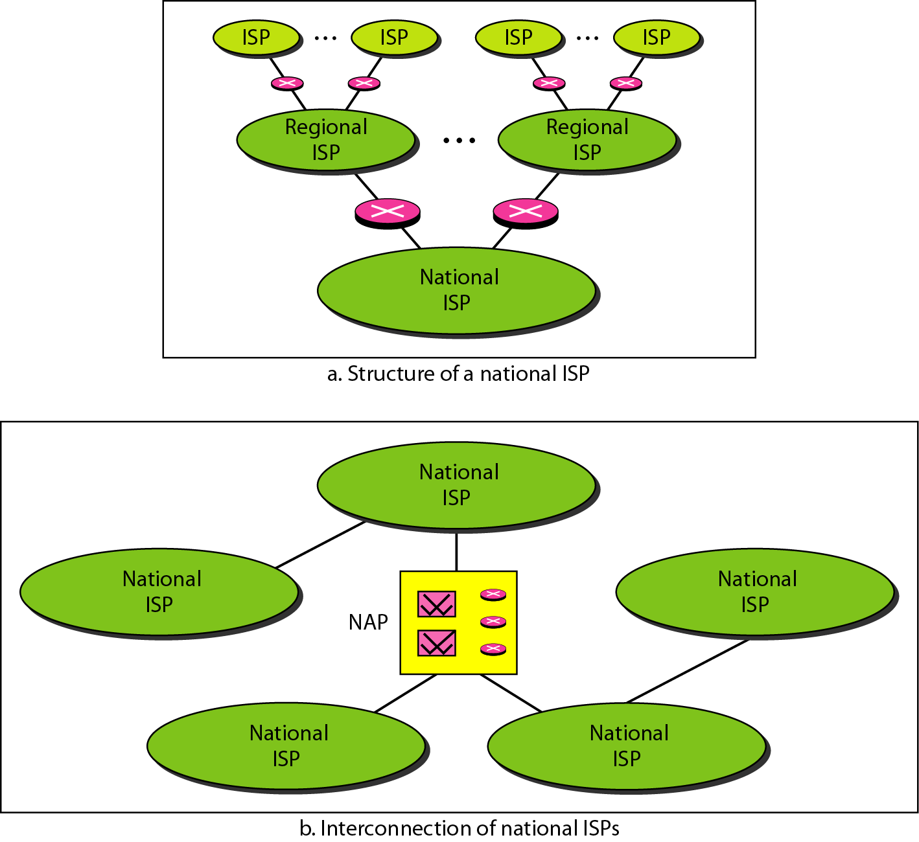
Internet(CO1)
When two or more networks are connected, they become an internetwork, or internet.

Slide 58
Physical layer (CO1)
Topic Objective
To understand the Physical Layer
Various transmission medium and
Switching methods
Recap of previous topic
The layered architecture of OSI and TCP/IP model
Comparison of both the models

Slide 59
OSI & TCP/IP models (CO1)
Topic Objective
To understand the OSI and TCP/IP models
Differences between two and the protocols supported
Recap of previous topic
The basic networking layout and topology were studied
Data flow mode supported

Slide 60
OSI Reference model(CO1)
OSI (Open System Interconnection) Reference model
Standardization of protocols used in various layers
Developed in 1983 revised in 1995
An open System is a set of protocols that allows any two different system to communicate regardless of their underlying architecture.
The purpose of the OSI model is to show how to communicate between two different system without required change underlying H/W and S/W.
The OSI model is not a protocols it is a model to understanding designing a n/w Architecture that is flexible, robust, and interoperable.
layers based on
A layer should be created where a different abstraction is needed
Each layer should perform a well-defined function
The function of each layer should be according to internationally standardized protocols
The layer boundaries should be chosen to minimize the information flow across the interfaces
The number of layers should be large enough for necessary functions required and small enough not to become unwieldy

Slide 61
Layered architecture(CO1)
Peer to peer process
Interfaces
Protocols
Header and trailer
Encapsulation
Seven layers
Physical
Data link
Network
Transport
Session
Presentation
Application

Slide 62
OSI Model(CO1)
Physical layer - coordinates the functions required to carry a bit stream over a physical medium
Physical characteristics of interfaces and medium
Representation of bits
Data rate
Synchronization of bits
Line configuration
Physical topology
Transmission mode
Data Link Layer - transforms the physical layer, a raw transmission facility, to a reliable link
Framing
Physical addressing
Flow control
Error control
Access control

Slide 63
OSI Model(CO1)
Network Layer - responsible for the source-to-destination delivery of a packet, possibly across multiple networks
Logical addressing
Routing
Transport Layer - process-to-process delivery of the entire message
Service-point addressing
Segmentation and reassembly
Connection control
Flow control
Error control
Session Layer - establishes, maintains, and synchronizes the interaction among communicating systems
Dialog control
Synchronization

Slide 64
OSI Model(CO1)
Presentation Layer - concerned with the syntax and semantics of the information exchanged between two systems
Translation
Encryption
Compression
Application Layer - enables the user to access the network
Network virtual terminal
File transfer, access, and management
Mail services
Directory services

Slide 65
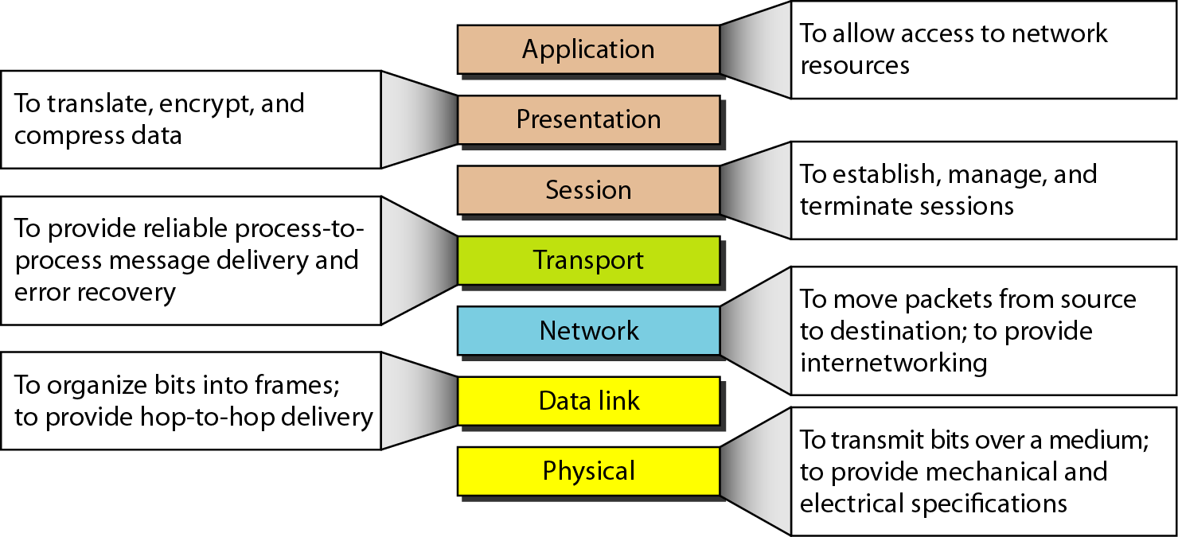
OSI Model(CO1)

Slide 66
TCP/IP model(CO3)
TCP/IP Model helps you to determine how a specific computer should be connected to the internet and how data should be transmitted between them. It helps you to create a virtual network when multiple computer networks are connected together. The purpose of TCP/IP model is to allow communication over large distances.
TCP/IP stands for Transmission Control Protocol/ Internet Protocol. TCP/IP Stack is specifically designed as a model to offer highly reliable and end-to-end byte stream over an unreliable internetwork.
TCP Characteristics
Support for a flexible TCP/IP architecture
Adding more system to a network is easy.
In TCP IP protocols suite, the network remains intact until the source, and destination machines were functioning properly.
TCP is a connection-oriented protocol.

Slide 67
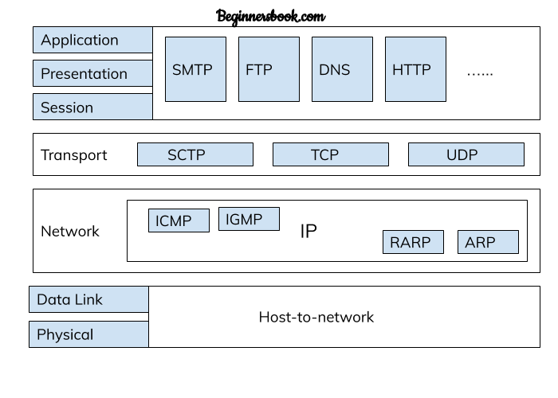
TCP/IP Model(CO3)

Slide 68
TCP/IP model(CO3)
Application Layer
Application layer interacts with an application program, which is the highest level of OSI model. The application layer is the OSI layer, which is closest to the end-user. It means the OSI application layer allows users to interact with other software application.
Application layer interacts with software applications to implement a communicating component. The interpretation of data by the application program is always outside the scope of the OSI model.
Example of the application layer is an application such as file transfer, email, remote login, etc.
The function of the Application Layers are
Application-layer helps you to identify communication partners, determining resource availability, and synchronizing communication.
It allows users to log on to a remote host
This layer provides various e-mail services

Slide 69
TCP/IP model(CO3)
Transport layer
It is builds on the network layer in order to provide data transport from a process on a source system machine to a process on a destination system.
It is hosted using single or multiple networks, and also maintains the quality of service functions.
It determines how much data should be sent where and at what rate. This layer builds on the message which are received from the application layer. It helps ensure that data units are delivered error-free and in sequence.
Transport layer helps you to control the reliability of a link through flow control, error control, and segmentation or de-segmentation.
The transport layer also offers an acknowledgment of the successful data transmission and sends the next data in case no errors occurred.
Functions of Transport Layers
It divides the message received from the session layer into segments and numbers them to make a sequence.
Transport layer makes sure that the message is delivered to the correct process on the destination machine.

Slide 70
TCP/IP model(CO3)
Internet Layer
An internet layer is a second layer of TCP/IP layes of the TCP/IP model. It is also known as a network layer. The main work of this layer is to send the packets from any network, and any computer still they reach the destination irrespective of the route they take.
The Internet layer offers the functional and procedural method for transferring variable length data sequences from one node to another with the help of various networks.
Message delivery at the network layer does not give any guaranteed to be reliable network layer protocol.
Layer-management protocols that belong to the network layer are:
Routing protocols
Multicast group management
Network-layer address assignment.

Slide 71
TCP/IP model(CO3)
Network Interface Layer
This is the bottom-most layer of the TCP/IP model architecture
It is a combination of the Data Link and Physical Layer of the OSI model
The physical transmission of data takes place at this layer
Once the frames are transmitted by a network, encapsulating the IP datagram into these frames is done in this layer
Also, the mapping of IP address into physical address is done here
Mainly, the function of this layer is to transmit the data between two devices, connected in a network

Slide 72
TCP/IP model(CO3)
Advantages TCP/IP model
It operated independently.
It is scalable.
Client/server architecture.
Supports a number of routing protocols.
Can be used to establish a connection between two computers.
Disadvantages
the transport layer does not guarantee delivery of packets.
The model cannot be used in any other application.
Replacing protocol is not easy.
It has not clearly separated its services, interfaces and protocols.

Slide 73
Comparison between OSI and TCP/IP(CO1)
TCP/IP
OSI
TCP refers to Transmission Control Protocol. | OSI refers to Open Systems Interconnection.
TCP/IP has 4 layers. | OSI has 7 layers.
TCP/IP is more reliable | OSI is less reliable
TCP/IP does not have very strict boundaries. | OSI has strict boundaries
TCP/IP follow a horizontal approach. | OSI follows a vertical approach.
TCP/IP uses both session and presentation layer in the application layer itself. | OSI uses different session and presentation layers.
TCP/IP developed protocols then model. | OSI developed model then protocol.

Slide 74
Comparison between OSI and TCP/IP
TCP/IP
OSI
TCP does not clearly distinguish between service, protocols and interfaces | OSI has explicit distinction between these.
Specific protocols | protocols are better hidden
Protocol based model | Protocols can be replaced as technology changes
Description of the protocols | General model
Protocols do not fit in the function | Protocols do not fit in the function

Slide 75
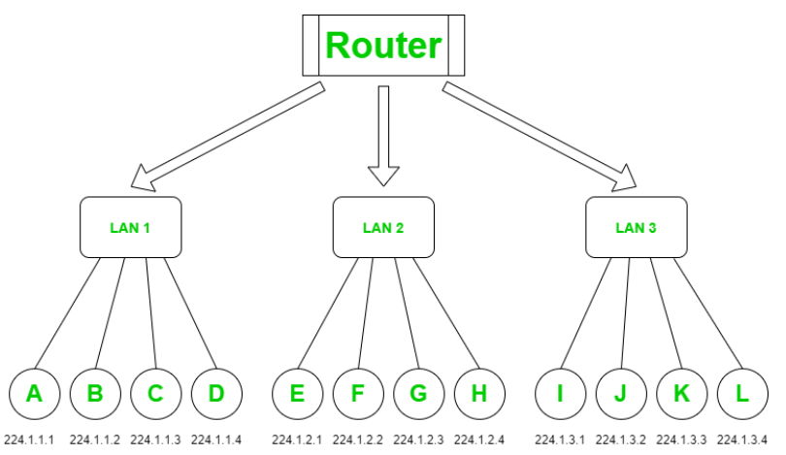
Addressing
Addressing
A Network Address is a logical or physical address that uniquely identifies a host or a machine in a telecommunication network. A network may also not be unique and can contain some structural and hierarchical information of the node in the network. Internet protocol (IP) address, media access control (MAC) address and telephone numbers are some basic examples of network addresses.
It is the prime responsibility of the network layer to assign unique addresses to different nodes in a network.
They can be physical or logical software-based addresses.
The most widely used network address is an IP address.

Slide 76
Addressing
IP address
An IP address is a 32-bit long numeric address represented in a form of dot-decimal notation where each byte is written in a decimal form separated by a period. For example 196.32.216.9 is an IP address where 196 represents first 8 bits, 32 next 8 bits and so on. The first three bytes of an IP address represents the network and the last byte specifies the host in the network.
An IP address is further divided into sub classes :
Class A : An IP address is assigned to those networks that include large number of hosts.
Class B : An IP address is assigned to networks range from small sized to large sized.
Class C : An IP address is assigned to networks that are small sized.
Class D : IP address are reserved for multicast address and does not possess subnetting.
Class E : An IP address is used for the future use and for the research and development purposes and does not possess any subnetting.
An IP address is divided into two parts:
Network ID : represents the number of networks.
Host ID : represents the number of hosts.

Slide 77
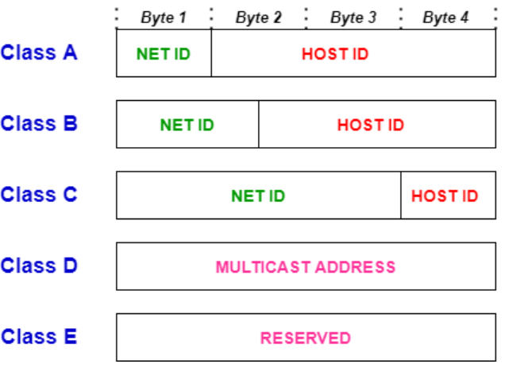
Addressing

Slide 78
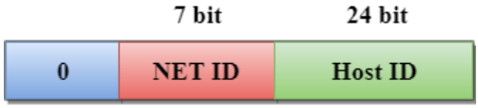
Addressing
Class A
In Class A, an IP address is assigned to those networks that contain a large number of hosts.
The network ID is 8 bits long.
The host ID is 24 bits long.
In Class A, the first bit in higher order bits of the first octet is always set to 0 and the remaining 7 bits determine the network ID. The 24 bits determine the host ID in any network.
The total number of networks in Class A = 27 = 128 network address
The total number of hosts in Class A = 224 - 2 = 16,777,214 host address

Slide 79
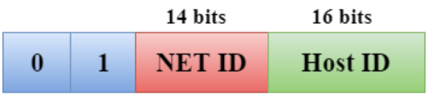
Addressing
Class B
In Class B, an IP address is assigned to those networks that range from small-sized to large-sized networks.
The Network ID is 16 bits long.
The Host ID is 16 bits long.
In Class B, the higher order bits of the first octet is always set to 10, and the remaining14 bits determine the network ID. The other 16 bits determine the Host ID.
The total number of networks in Class B = 214 = 16384 network address
The total number of hosts in Class B = 216 - 2 = 65534 host address

Slide 80
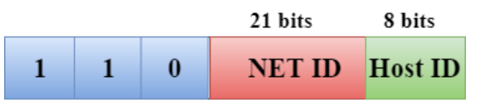
Addressing
Class C
In Class C, an IP address is assigned to only small-sized networks.
The Network ID is 24 bits long.
The host ID is 8 bits long.
In Class C, the higher order bits of the first octet is always set to 110, and the remaining 21 bits determine the network ID. The 8 bits of the host ID determine the host in a network.
The total number of networks = 221 = 2097152 network address
The total number of hosts = 28 - 2 = 254 host address

Slide 81
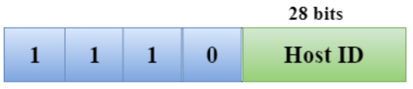
Addressing
Class D
In Class D, an IP address is reserved for multicast addresses. It does not possess subnetting. The higher order bits of the first octet is always set to 1110, and the remaining bits determines the host ID in any network.
Class E
In Class E, an IP address is used for the future use or for the research and development purposes. It does not possess any subnetting. The higher order bits of the first octet is always set to 1111, and the remaining bits determines the host ID in any network.

Slide 82
Type of Addressing
Physical addressing
The physical address is the lowest level of address. This means the physical address is specifically for the intra-networking environment. Using physical addressing, a node can send a frame to another node in the same physical network
The physical address can be further classified into unicast, multicast and broadcast address. The physical unicast address is assigned to the frame that has to be sent to a single recipient. A physical multicast address is included in the frame that has to be sent to a group of recipients. The physical broadcast address is included in the frame that has to be sent to all the nodes or all the systems connected to the network.

Slide 83
Type of Addressing
Logical addressing
The logical address is the IP address that is provided to the nodes connected to the internet and no two nodes here can have the same IP address. Like physical addresses, the logical addresses are classified to unicast (single receiver), multicast (multiple receivers) and broadcast (all the nodes of the system). Though broadcasting has some limit on the number of recipients.
Port Address
The computer runs multiple processes at a time. So, to identify for which process the data has arrived, we need to label the process to identify each process in a computer uniquely. In TCP/IP architecture, the address of a process is termed a port address.
Specific address
specific addresses are used to identify particular applications.
For example, author@beingintelligent.com is the address of the email, and www.beingintelligent.com is the address of the website.

Slide 84
Digital to Analog
Digital-to-analog conversion is the process of changing one of the characteristics of an analog signal based on the information in digital data.
Digital data needs to be carried on an analog signal.
A carrier signal (frequency f_{c}) performs the function of transporting the digital data in an analog waveform.
The analog carrier signal is manipulated to uniquely identify the digital data being carried.

Slide 85
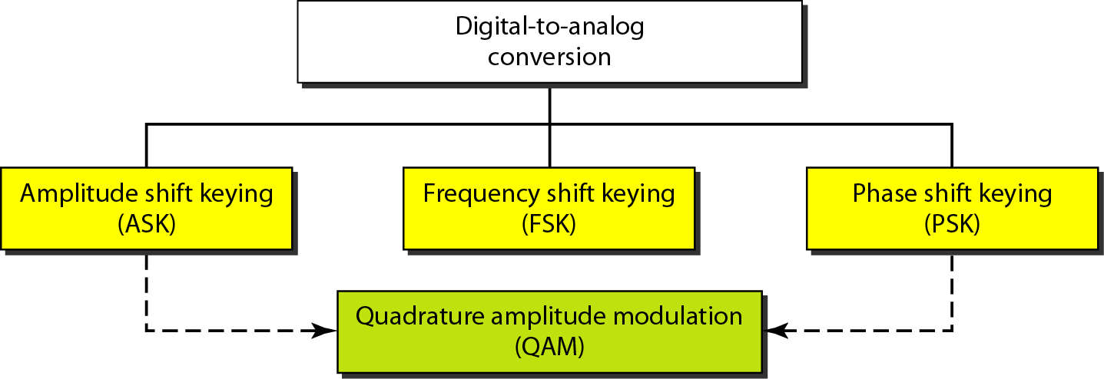
Digital to Analog conversion(CO2)

Slide 86
Digital Data
PERIODIC ANALOG SIGNALS
A simple periodic analog signal, a sine wave.
A composite periodic analog signal is composed of multiple sine waves.
The three parameters: the peak amplitude, the frequency, and the phase
Time and Frequency Domains
Bandwidth
Bitrate
Bit length

Slide 87
Transmission impairment
Causes
Attenuation – loss of energy
Distortion– change in shape & form of signal
Noise – extra signal

Slide 88
Data Rate(CO2)
A very important consideration in data communications is how fast we can send data, in bits per second, over a channel. Data rate depends on three factors:
1. The bandwidth available
2. The level of the signals we use
3. The quality of the channel (the level of noise)
Noiseless Channel: Nyquist Bit Rate
Noisy Channel: Shannon Capacity
Using Both Limits

Slide 89
Physical Layer
Digital signals
0 and 1
For no. of levels (L) require log₂ L bits
Bit rate – no. of bits send per second(bps)
Bit length
Transmitted by
Baseband transmission
Broadband transmission (using modulation)
TRANSMISSION IMPAIRMENT
Attenuation Distortion Noise
Impairment causes

Slide 90
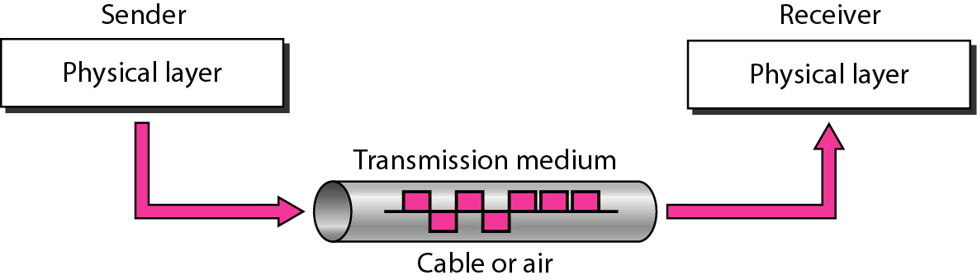
Transmission medium(CO2)

Slide 91
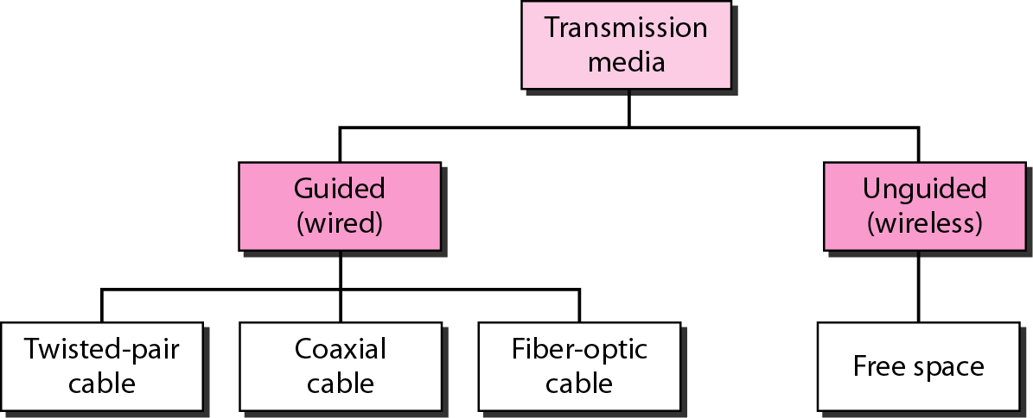
Transmission media(CO2)

Slide 92
Transmission media - guided
Guided media, which are those that provide a conduit from one device to another
Twisted-Pair Cable
Coaxial Cable
Fiber-Optic Cable

Slide 93
Transmission media - guided
Twisted Pair cable

Slide 94
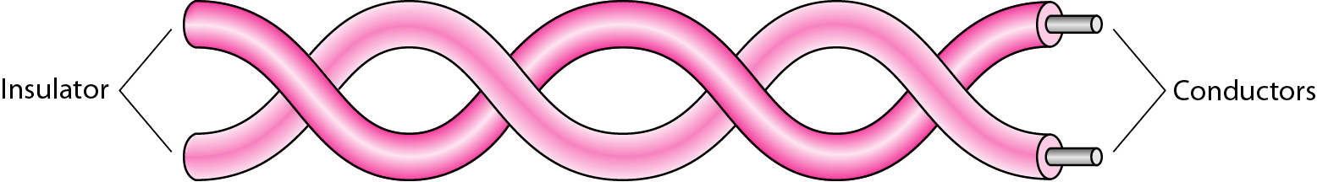
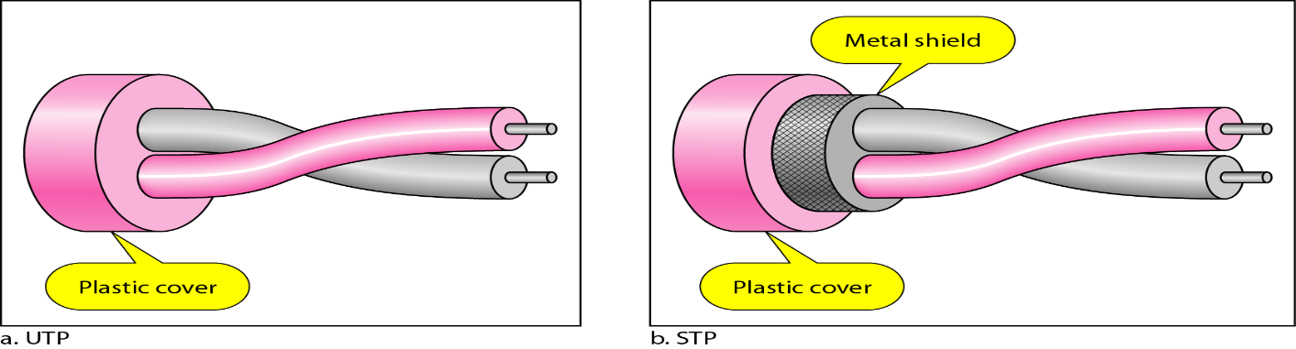
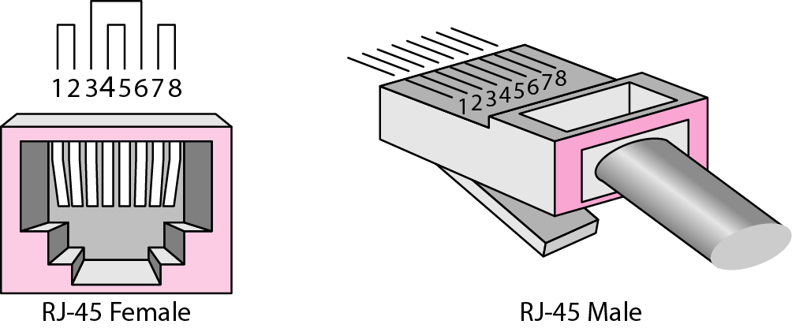
Transmission media - guided
Twisted Pair cable

Slide 95
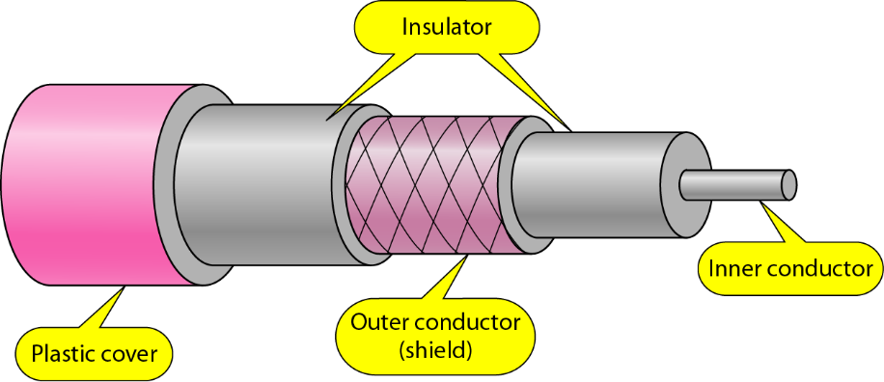
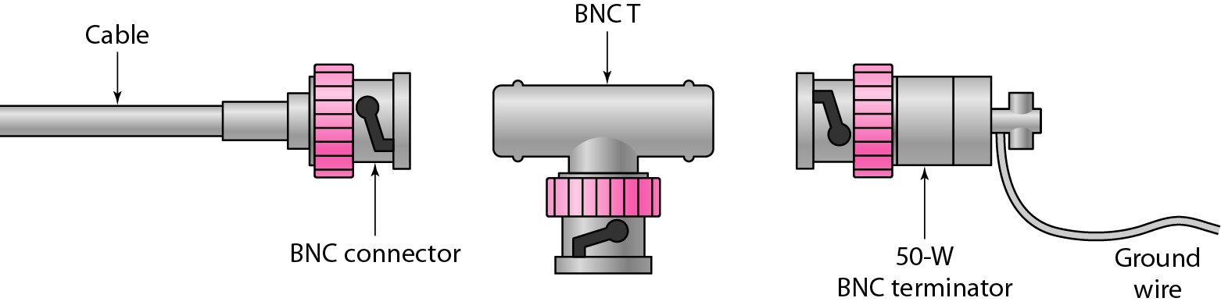
Transmission media - guided
Coaxial Cable

Slide 96
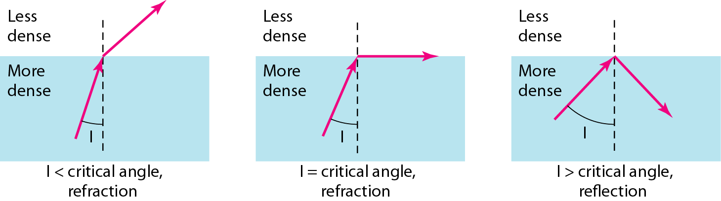
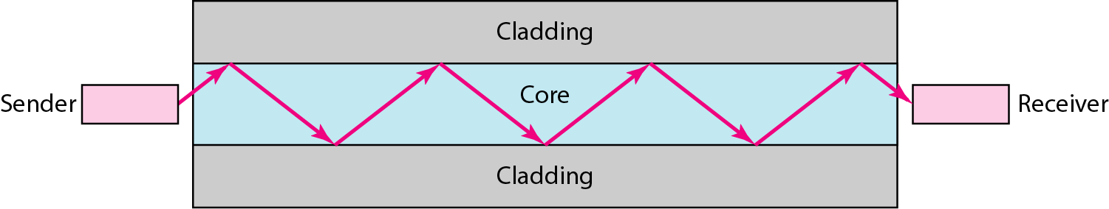
Transmission media - guided
Fiber Optic Cable based on

Slide 97
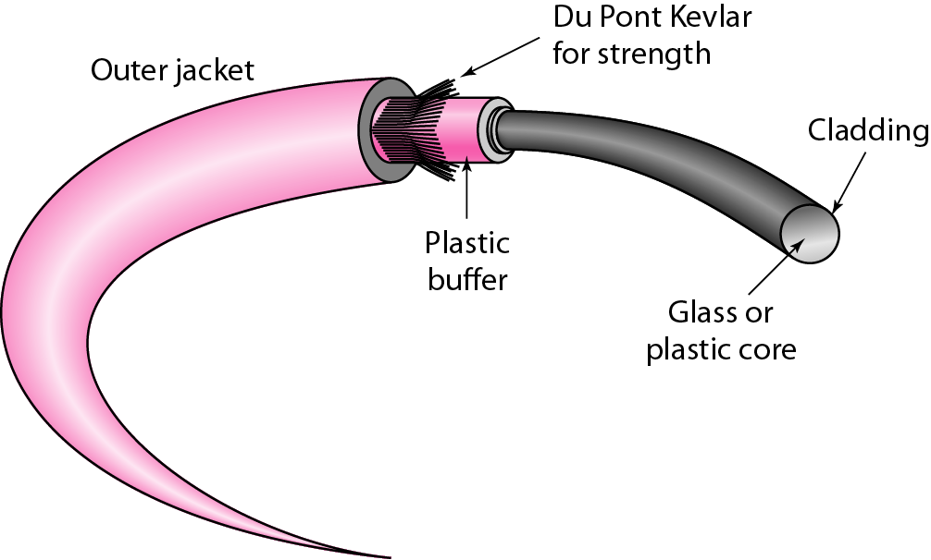
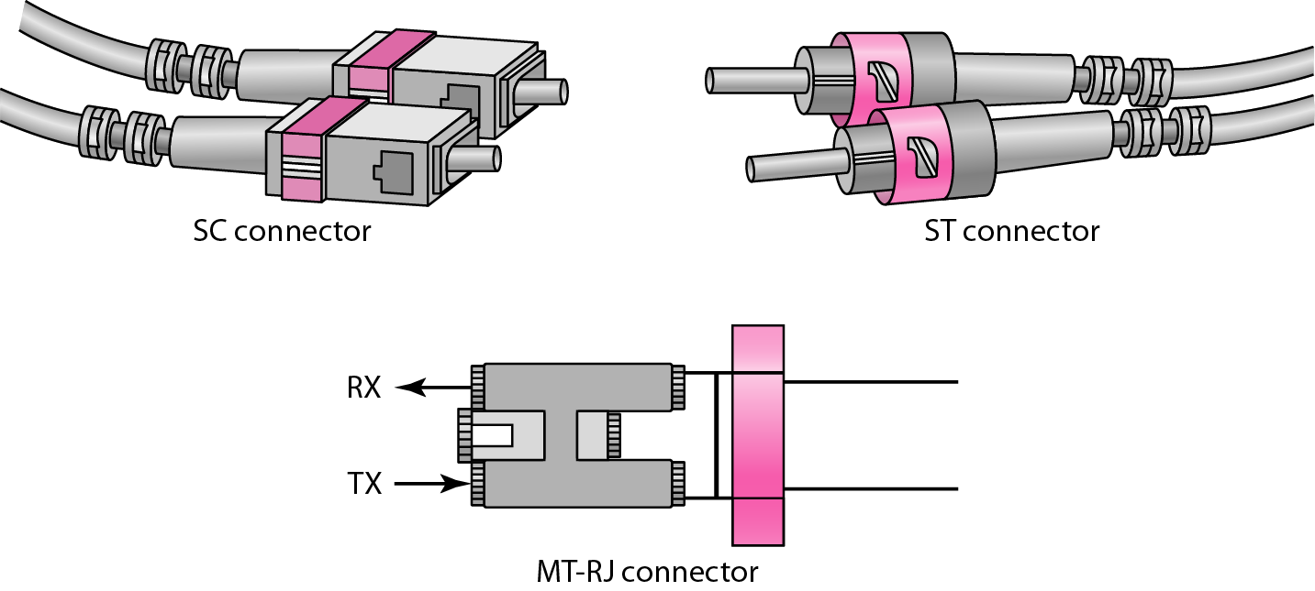
Transmission media - guided
Fiber optic Cable

Slide 98
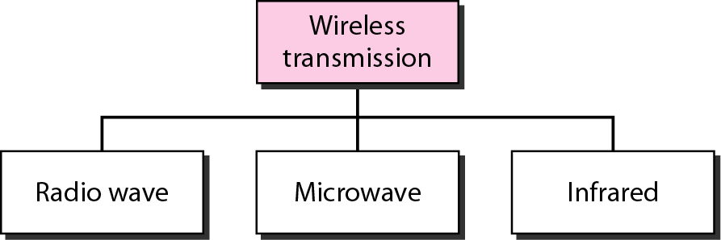
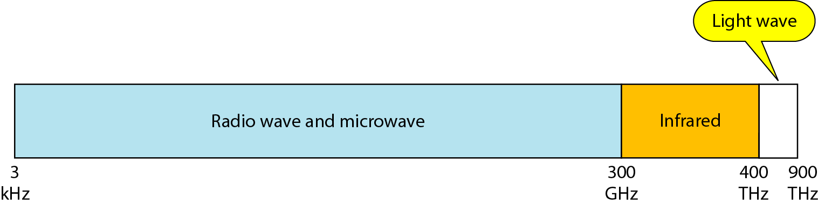
Transmission media - unguided
Unguided media transport electromagnetic waves without using a physical conductor. This type of communication is often referred to as wireless communication.

Slide 99
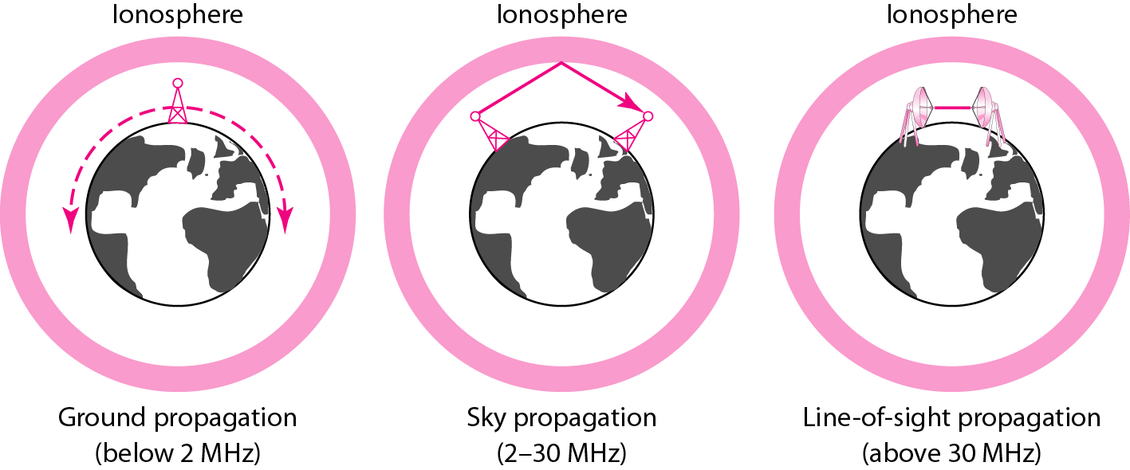
Transmission media - unguided
Propagation modes

Slide 100
Transmission media - unguided

Slide 101
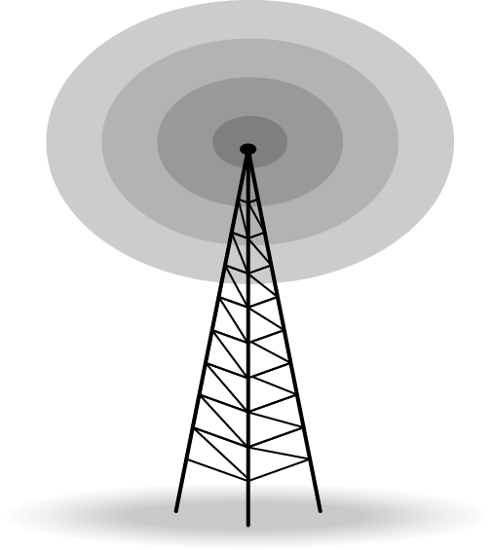
Transmission media - unguided
Wireless communication
Radio waves are used for multicast communications, such as radio and television, and paging systems. They can penetrate through walls. Highly regulated. Use omni directional antennas

Slide 102
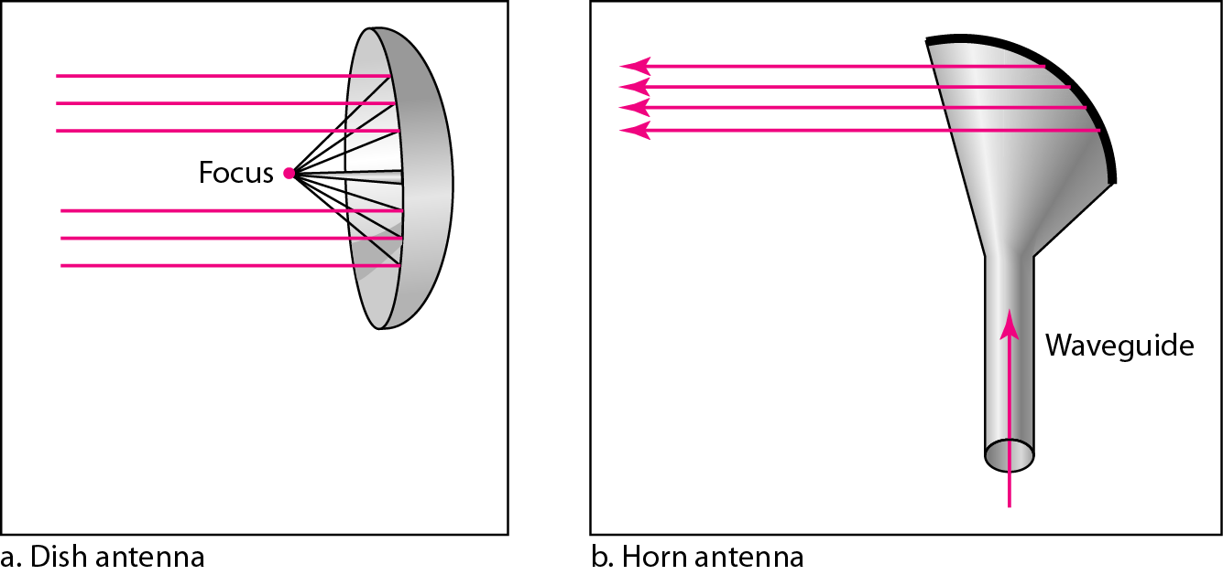
Transmission media - unguided
Wireless communication
Microwaves are used for unicast communication such as cellular telephones, satellite networks, and wireless LANs. Higher frequency ranges cannot penetrate walls. Use directional antennas - point to point line of sight communications.

Slide 103
Transmission media - unguided
Wireless communications
Infrared signals can be used for short-range communication in a closed area using line-of-sight propagation.
Disadvantages of wireless channels
Are subject to a lot more errors than guided media channels.
Interference is one cause for errors, can be circumvented with high SNR.
The higher the SNR the less capacity is available for transmission due to the broadcast nature of the channel.
Channel also subject to fading and no coverage holes.

Slide 104
Switching methods(CO2)
Switched communication networks are those in which data transferred from source to destination is routed between various intermediate nodes. Switching is the technique by which nodes control or switch data to transmit it between specific points on a network.

Slide 105
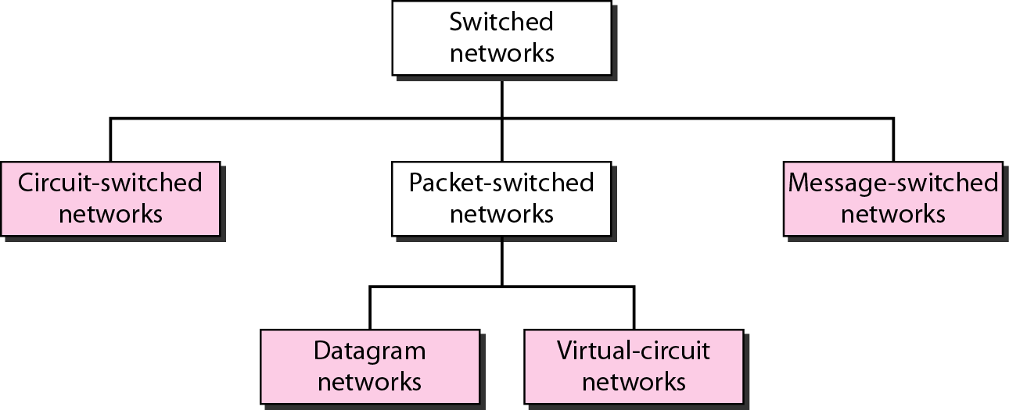
Switching methods(CO2)

Slide 106
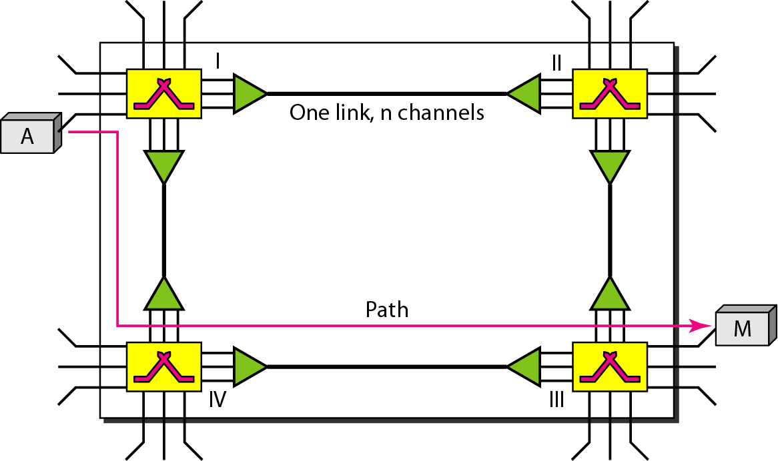
Switching methods(CO2)
Circuit switched
consists of a set of switches connected by physical links.
A connection between two stations is a dedicated path made of one or more links.
Each connection uses only one dedicated channel on each link.
Each link is normally divided into n channels by using FDM or TDM.

Slide 107
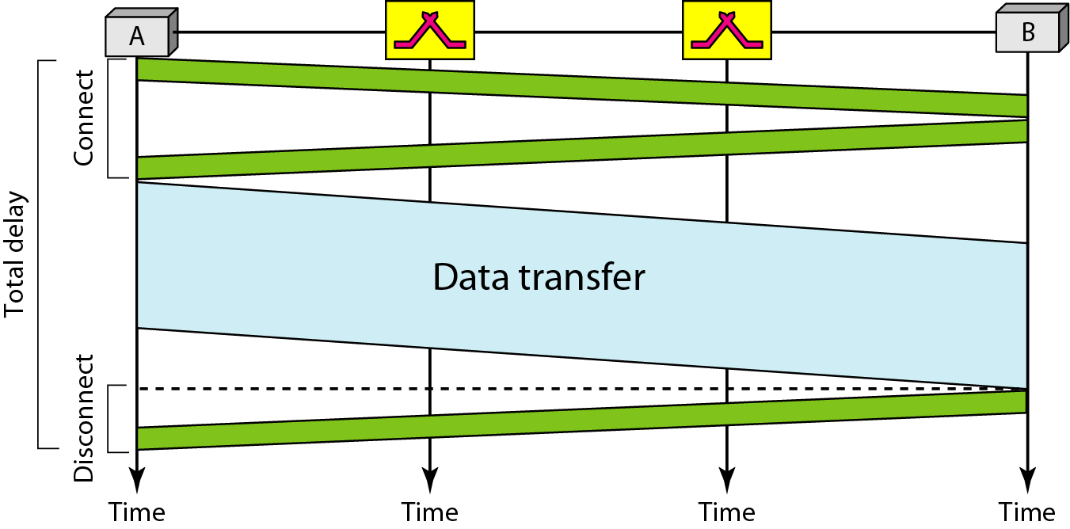
Switching methods(CO2)
Delay in Circuit switched

Slide 108
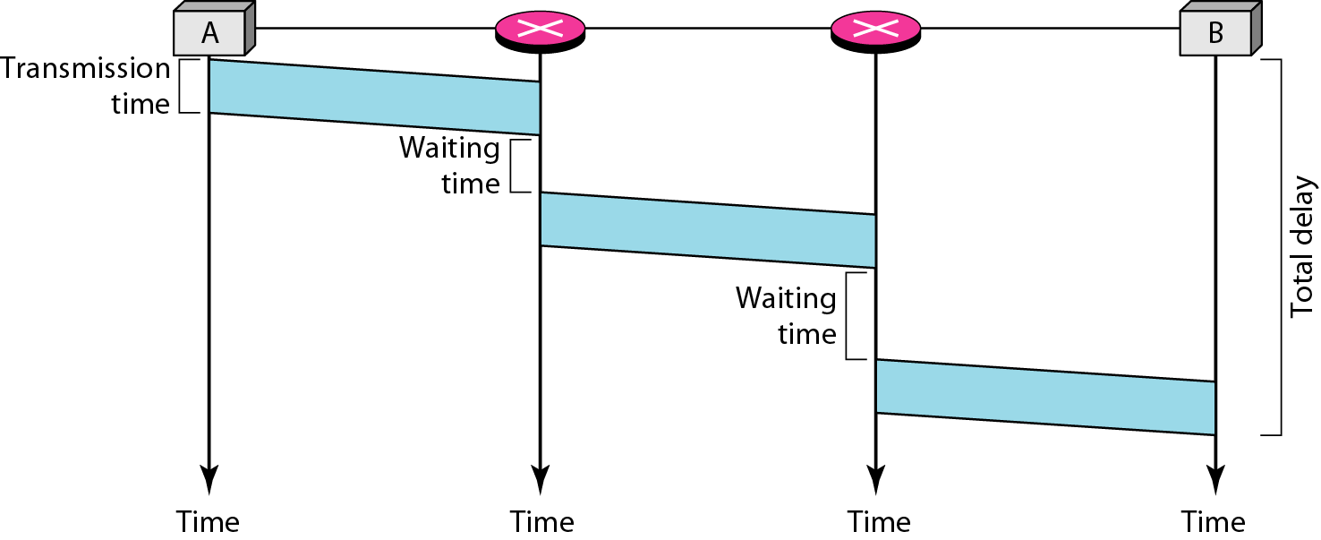
Switching methods(CO2)
Delay in datagram network

Slide 109
Switching methods(CO2)
Packet switched
send messages from one end system to another.
If the message is going to pass through a packet-switched network, it needs to be divided into packets of fixed or variable size.
The size of the packet is determined by the network and the governing protocol.
In a packet-switched network, there is no resource reservation; resources are allocated on demand.

Slide 110
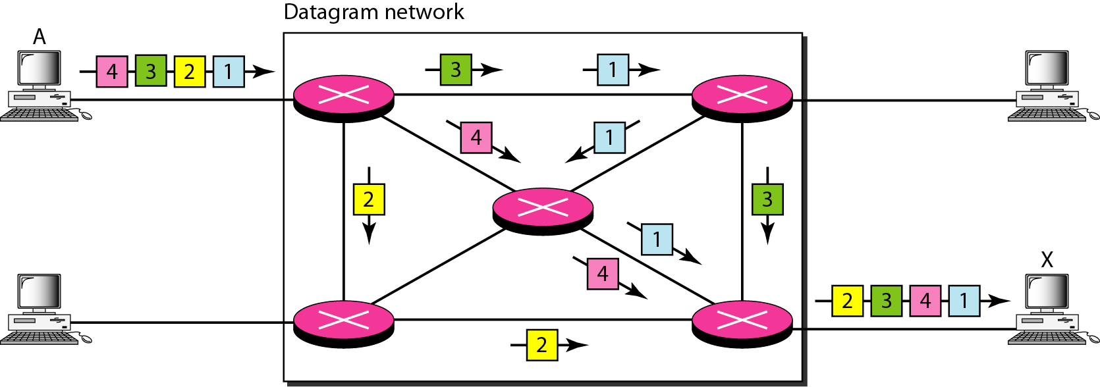
Switching methods(CO2)
Packet switched – Datagram network

Slide 111
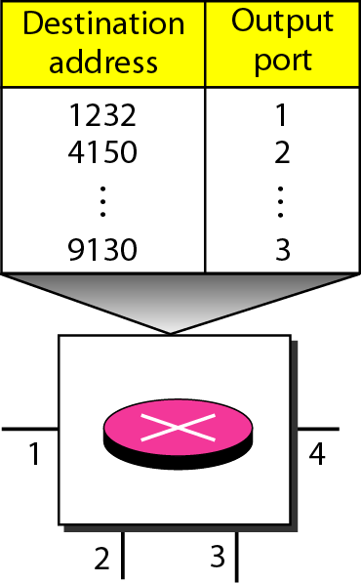
Switching methods(CO2)
Packet Switched – Datagram Network
Routing table
A switch in a datagram network uses a routing table that is based on the destination address.
The destination address in the header of a packet in a datagram network remains the same during the entire journey of the packet.

Slide 112
Switching methods(CO2)
Packet Switched - Virtual-circuit network
a cross between a circuit-switched network and a datagram network.
It has some characteristics of both.
all packets belonging to the same source and destination travel the same path;
but the packets may arrive at the destination with different delays if resource allocation is on demand.

Slide 113
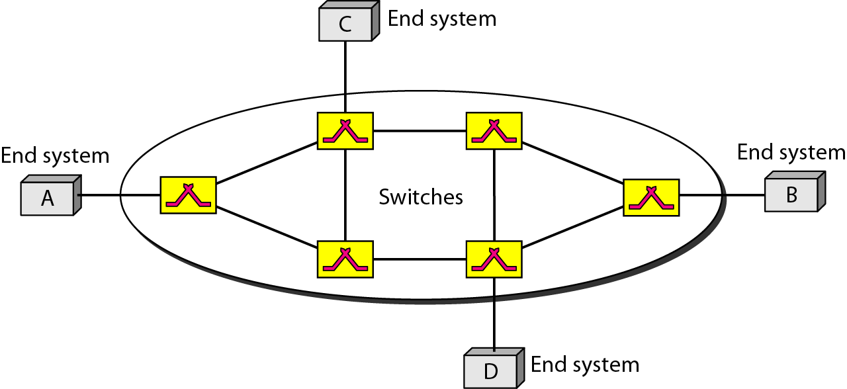
Switching methods(CO2)
Packet Switched - Virtual-circuit network

Slide 114
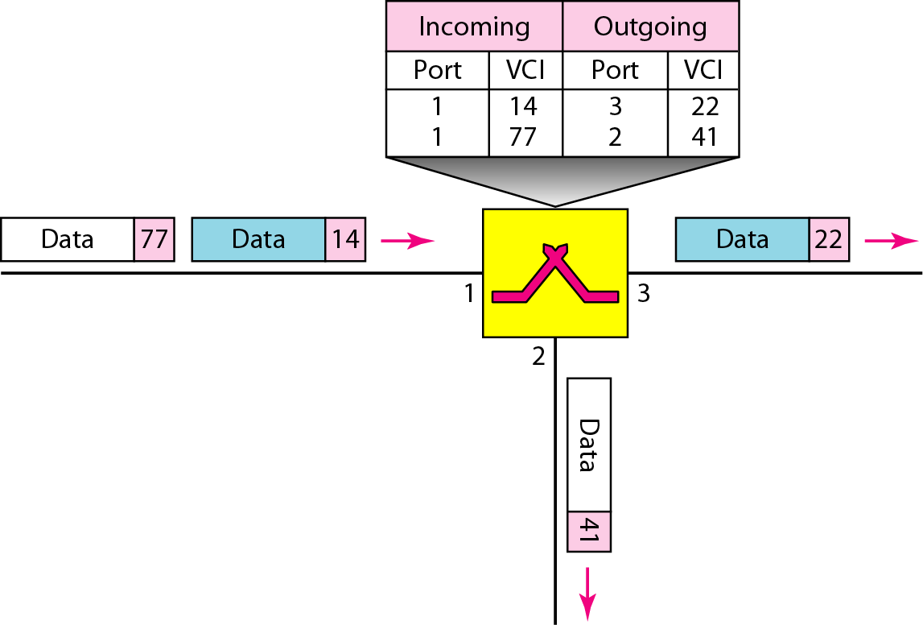
Switching methods(CO2)
Packet Switched - Virtual-circuit network

Slide 115
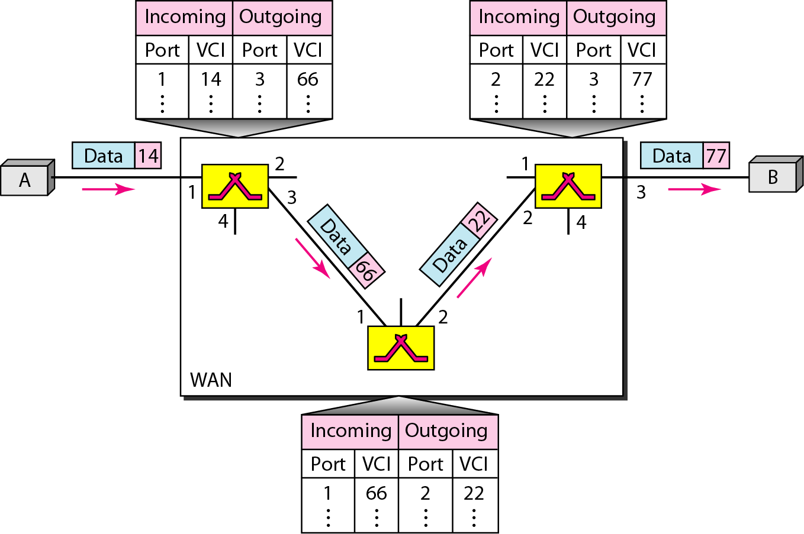
Switching methods(CO2)
Packet Switched - Virtual-circuit network

Slide 116
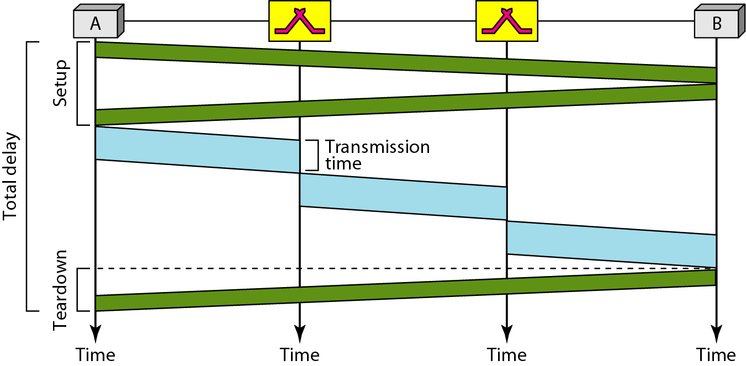
Switching methods(CO2)
Delay in virtual circuit

Slide 117
ISDN and Terminal Handling(CO2)
Topic Objective
To understand the ISDN services
Understand Terminal Handling
Recap of previous topic
Various transmission media used in physical layer
Switching methods used for transmission

Slide 118
Integrated Services Digital Network(CO2)
ISDN
These are a set of communication standards for simultaneous digital transmission of voice, video, data, and other network services
a circuit-switched telephone network system, but it also provides access to packet switched networks that allows digital transmission of voice and data.
ISDN is employed as the network in data-link and physical layers
The ISDN works based on the standards defined by ITU-T
The various principles of ISDN
To support switched and non-switched applications
To support voice and non-voice applications
Reliance on 64-kbps connections
Intelligence in the network
Layered protocol architecture
Variety of configurations

Slide 119
Integrated Services Digital Network(CO2)
Services
Bearer Services-Transfer of information between users without the network manipulating the content of that information
Teleservices - the network may change or process the contents of the data.
Supplementary Service - Additional functionality to the bearer services and teleservices

Slide 120
Terminal Handling
A computer terminal is an electromechanical or electronic hardware device which is used for entering data into, and displaying data from a computing system or computer.
The early terminals were inexpensive but slower than punched cards or paper tape for input.
Video displays were introduced with the advancement in technology.
Time sharing systems also developed.
Multiple users could work on the same machine at their own terminals.
A smart terminal has a significant local programmable data processing capability.
A terminal which depends on the host computer for its processing power is known as a client.
A personal computer can run software which emulates the function of a terminal and can sometimes allow concurrent use of local programs and access to a distant terminal host system

Slide 121

Multiplexing
Multiplexing is a technique used to combine and send the multiple data streams over a single medium. The process of combining the data streams is known as multiplexing and hardware used for multiplexing is known as a multiplexer.
Multiplexing is achieved by using a device called Multiplexer (MUX) that combines n input lines to generate a single output line. Multiplexing follows many-to-one, i.e., n input lines and one output line.
Demultiplexing is achieved by using a device called Demultiplexer (DEMUX) available at the receiving end. DEMUX separates a signal into its component signals (one input and n outputs).

Slide 122

Multiplexing
Multiplexing is a technique used to combine and send the multiple data streams over a single medium. The process of combining the data streams is known as multiplexing and hardware used for multiplexing is known as a multiplexer.
Multiplexing techniques can be classified as:

Slide 123

Multiplexing
Frequency-division Multiplexing (FDM)
It is an analog technique.
Frequency Division Multiplexing is a technique in which the available bandwidth of a single transmission medium is subdivided into several channels.
In the above diagram, a single transmission medium is subdivided into several frequency channels, and each frequency channel is given to different devices. Device 1 has a frequency channel of range from 1 to 5.
FDM is mainly used in radio broadcasts and TV networks.

Slide 124

Multiplexing
Wavelength Division Multiplexing (WDM)
Wavelength Division Multiplexing is same as FDM except that the optical signals are transmitted through the fibre optic cable.
WDM is used on fibre optics to increase the capacity of a single fibre.
It is used to utilize the high data rate capability of fibre optic cable.
It is an analog multiplexing technique.

Slide 125

Multiplexing
Time Division Multiplexing (TDM)
It is a digital technique.
In Frequency Division Multiplexing Technique, all signals operate at the same time with different frequency, but in case of Time Division Multiplexing technique, all signals operate at the same frequency with different time.
In Time Division Multiplexing technique, the total time available in the channel is distributed among different users. Therefore, each user is allocated with different time interval known as a Time slot at which data is to be transmitted by the sender.
There are two types of TDM:
Synchronous TDM
Asynchronous TDM

Slide 126
IEEE Standards
IEEE standards in computer networks | Description
IEEE 802 | It is used for the overview and architecture of LAN/MAN.
IEEE 802.1 | It is used for bridging and management of LAN/MAN.
IEEE 802.1s | It is used in multiple spanning trees.
IEEE 802.1 w | It is used for rapid reconfiguration of spanning trees.
IEEE 802.1x | It is used for network access control of ports.
IEEE 802.2 | It is used in Logical Link Control (LLC).
IEEE 802.3 | It is used in Ethernet (CSMA/CD access method).
IEEE 802.3ae | It is used for 10 Gigabit Ethernet.
IEEE 802.4 | It is used for token passing bus access methods and the physical layer specifications.
IEEE 802.5 | It is used for token ring access methods and the physical layer specifications.

Slide 127
IEEE Standards
IEEE standards in computer networks | Description
IEEE 802.6 | It is used in distributed Queue Dual Bus (DQDB) access method and for the physical layer specifications (MAN).
IEEE 802.7 | It is used in broadband LAN.
IEEE 802.8 | It is used in fiber optics.
IEEE 802.9 | It is used in isochronous LANs.
IEEE 802.10 | It is used in interoperable LAN/MAN security.
IEEE 802.11 | It is used in wireless LAN, MAC, and Physical layer specifications.
IEEE 802.12 | It is used in the demand-priority access method, in the physical layer, and in repeater specifications.
IEEE 802.13 | It is not used.
IEEE 802.14 | It is used in cable modems (not used now).
IEEE 802.15 | It is used in WPAN (Wireless Personal Area Network).
IEEE 802.16 | It is used in Wireless MAN (Wireless Metropolitan Area Network).
IEEE 802.17 | It is used in RPR access (Resilient Packet Ring).

Slide 128
MCQ s
A communication between a computer and a keyboard depicts
full duplex transmission
half duplex transmission
simplex transmission
Both A and B
_________ model is a protocol based model
OSI
IEEE
TCP/IP
All of the above

Slide 129
MCQ s
Computer Network can be defined as
Multiple devices interconnected with a communication channel
Collection of hardware components and computers
Sharing of resources and information
All of the above
The information to be communicated in the data communication system is the
Message
Medium
Protocol
Transmission

Slide 130
MCQ s
The Full form of ANSI is
American Notation for standard international
American national standardization Institute
American notion standards Institute
American national Standards Institute
The oldest and the still most commonly used transmission media is
Twisted pair cable
Coaxial cable
Fiber optic
WiFi

Slide 131
MCQ s
The example of guided media is
Twisted pair cable
Coaxial cable
Fiber optic cable
All of the above
Effectiveness of a data communication depends on
Timeliness
Delivery
Accuracy
All of the above

Slide 132
Glossary
___________ are used for unicast communication such as cellular telephones, satellite networks
One long cable acts as a backbone to link all the devices in a _____Topology
A computer network is an interconnection of two or more computers that are able to _____ _______
_______ _______ is a physical path by which message transmits
_______a set of rules that govern data communications
the number of physical links in a fully connected mesh network with n nodes = ______
The devices are connected through a _____ in star topology
LANs are distinguished from other types of networks by their ______ and _________

Slide 133
Weekly Assignment
1. Compare and contrast the ISO OSI model with TCP/IP model. CO1
2. Give advantages and disadvantages of fiber optic cable over metallic cable. Explain the use and design of latest technology used for transmission. CO1
3. A device is sending out data at the rate of 2000 bps. How long does it take to send out 100 bits? CO1
4. If you have to set up a lab of 50 computers, which topology will you use and why? CO1
5. Differentiate between connection oriented and connectionless communication. CO1

Slide 134
Weekly Assignment
6. List some applications of networking. CO1
7. Discuss the design issues for the layers in computer Networks.CO1
8. We modulate several voice signals and send them through the air. Is this baseband or broadband transmission. CO1
9. A periodic composite signal contains frequencies from 20 to 30 kHz, each with an amplitude of 8V. Draw the frequency spectrum. CO1
10. A signal travels from point A to point B. At point A, the signal power is 200 W. At point B, the power is 170 W. What is the attenuation in decibels? CO1

Slide 135
Faculty Video Links, Youtube & NPTEL Video Links and Online Courses Details
Youtube/other Video Links
https://www.youtube.com/watch?v=lnU-Zw3NEEQ
https://www.youtube.com/watch?v=kNKHM_isojI
https://www.youtube.com/watch?v=vv4y_uOneC0

Slide 136
Old Question Papers
18-19
https://drive.google.com/open?id=17OUMNnX0kFDc9UB8tx8qd8zyEj7lCD5P
17-18
https://drive.google.com/open?id=1oFmw__qC7wdUP85gUkKbkohZvd9Vopm_
16-17
https://drive.google.com/open?id=1eDrOkj2wVsxdTZPb7-A78YuYn16HC1ob
15-16
https://drive.google.com/open?id=1ljNxmZP1_pl10rbxJvK6xB1ybG7AMuqU
14-15
https://drive.google.com/open?id=1tjERKPwEA9icWcQTBZQnKUq_ttqBDeo5

Slide 137

Question paper of University Exam

Slide 138

Question paper of University Exam

Slide 139

Question paper of University Exam

Slide 140

Question paper of University Exam

Slide 141
Expected Questions for University Exam
Write the function of physical layer of ISO-OSI reference model.CO1
What is a protocol? CO1
List some applications of networking. CO1
Explain different transmission media used for networking? CO1
What are the goals of networking? CO1
Explain the difference between OSI and TCP/IP model. CO1
Define topology with advantage and disadvantage. CO1

Slide 142
Summary
Understanding of Network structure and Architecture.
The layout of OSI reference model and TCP/IP model.
Various Network Topology Design used .
The different Networking.
Physical Layer and types of Transmission Media.
Overview of ISDN and Terminal Handling.

Slide 143
References
1. Forouzen, "Data Communication and Networking", TMH
2. A.S. Tanenbaum, Computer Networks, Pearson Education
3. W. Stallings, Data and Computer Communication, Macmillan Press
4. Gary R.Wright, W.Richard Stevens "TCP/IP Illustrated,Volume2 The Implementation" Addison-Wesley
5. Michael A. Gallo and William M. Hancock "Computer communication and Networking Technology" Cengage Learning
6. Bhavneet Sidhu, An Integrated approach to Computer Networks, Khanna Publishing House
7. Anuranjan Misra, “Computer Networks”, Acme Learning
8. G. Shanmugarathinam, ”Essential of TCP/ IP”, Firewall Media

Slide 144
Text Books
Behrouz Forouzan, “Data Communication and Networking”, McGraw Hill
2. Andrew Tanenbaum “Computer Networks”, Prentice Hall.
3. William Stallings, “Data and Computer Communication”, Pearson.

Slide 145
Thank You

